Slide 1
Cinvestav
Thesis Project Status
dario.bahena@oracle.com, May 10th

Slide 2
Where were we?
Lanczos (IRLM), TraceMin-Fiedler and LOBPCG were giving different times with domain matrix and with randomly generated ones.
Wanted to understand why
Also wanted to reproduce TraceMin-Fiedler results published on original article.
Miscellaneous checks (matrix format, % sparsity)
Application context (additional info)
Adjusted scope and new approach

Slide 3
First TraceMin-Fiedler …
Got TraceMin articles (thanks Isaac and Andrés)
We got code from original author! (thanks Andrés)
Implementation in Fortran 90, but not a serial one: uses parallelism at many levels (optimized/vectorized BLAS/LAPACK, OpenMP and MPI).
Installed Intel tools and could compile (including the Python wrapper)
But linkage errors came, with or without the Python wrapper. Paused this effort to move forward.

Slide 4
Now the misc checks ...
There does not seem to be a big difference in terms of sparse formats for the algorithms (tried with CSR vs CSC).
Scipy documentation about CSR vs CSC indicates they differ only in row vs column slicing capability.
Random matrix generator was correct regarding % zeroes, issue was format related (was not leveraging symmetry flag of MatrixMarket in domain matrix).

Slide 5
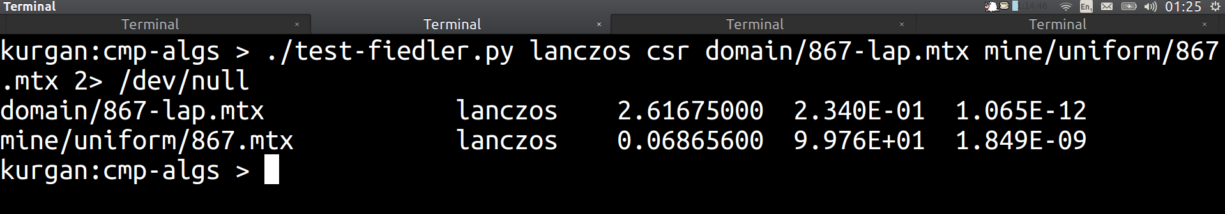
Let us begin: Lanczos (IRLM)
Why these differences in elapsed time?
TraceMin-Fiedler/LOBPCG gives also interesting time differences, but focused on ARPACK's IRLM.

Slide 6
Idea1: matrix distribution
What if we see the matrix as generated by a random number generator of certain distribution?
Only need to take lower (or upper) triangular portion due symmetry, flatten it and see that as the random sequence.
Can visualize the PDF (Probability Density Function) with a normalized histogram (integral over curve sums 1).
Let us see the histograms of both matrices then ...

Slide 7
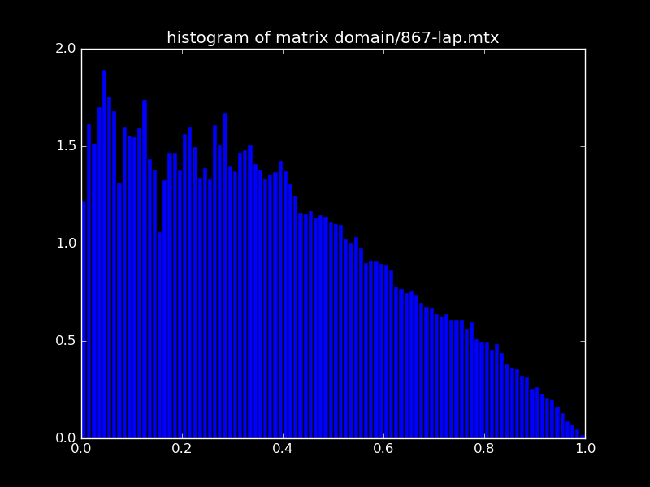
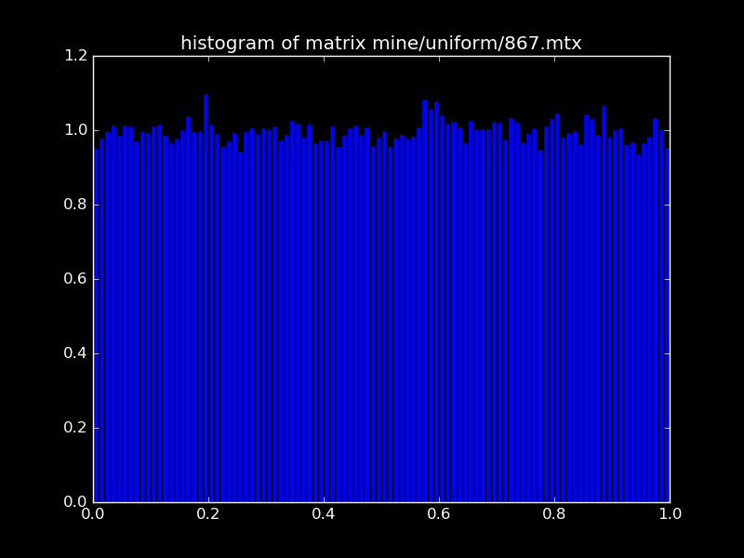
Idea1: histograms

Slide 8
Idea1: what is domain dist?
The histograms suggest quite different distributions!
Could the domain distribution cause the slowness?
Let us find out what distribution it has, so we can generate random matrices with the same (instead of uniform).
Scipy has 89 distributions, and all of them offer a "fit" method (Maximum Likelihood Method).
We tried them all … let us see what was best fit.

Slide 9
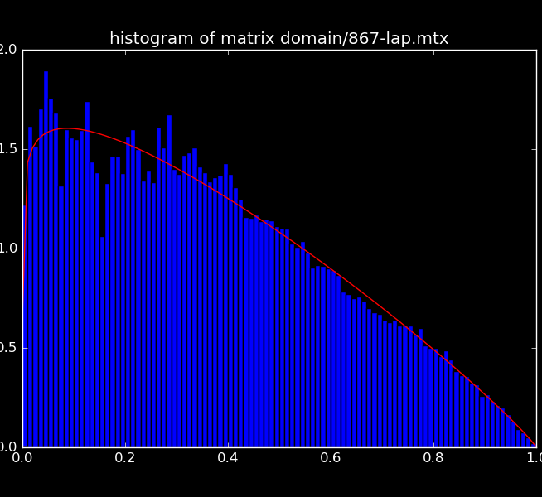
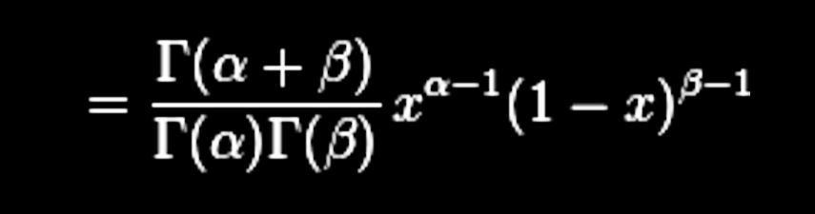
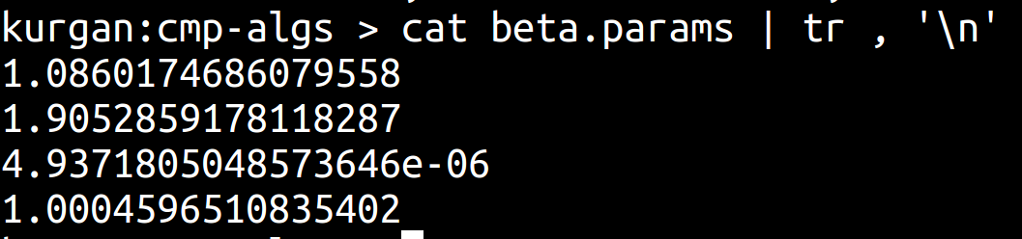
Idea1: domain matrix ~ beta

Slide 10
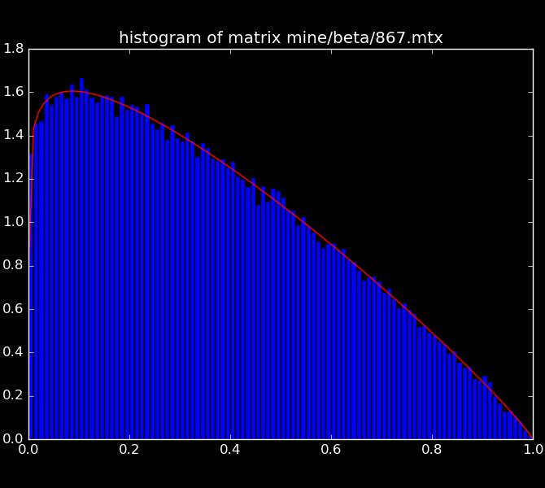
Idea1: random beta matrix

Slide 11
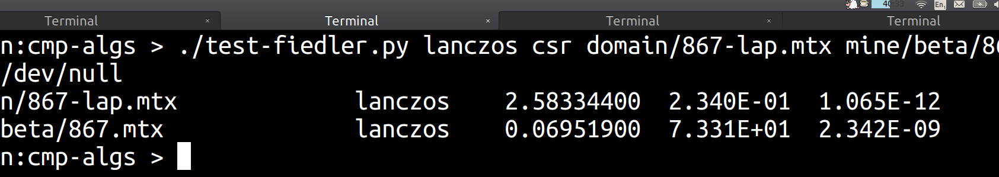
Idea1: #FAIL
Can we reproduce slowness of domain matrix with beta random matrix? NO!

Slide 12
Idea2: eigenvalues
Literature usually reports convergence results in terms of the eigenvalues themselves (specially for Power-method family, which includes our IRLM).
Furthermore, Laplacian matrix has smallest eigenvalue zero; so critical value should be how distant is the second smallest (we only asks for these two).
If we plot the eigenvalues of domain vs random matrices, what do we get?

Slide 13
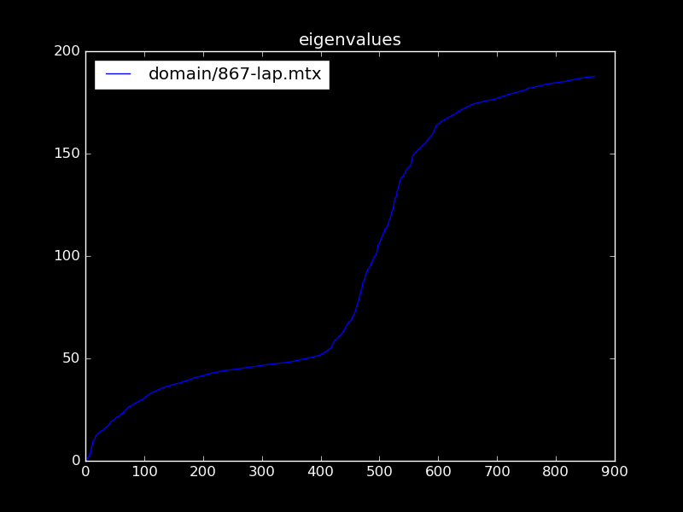
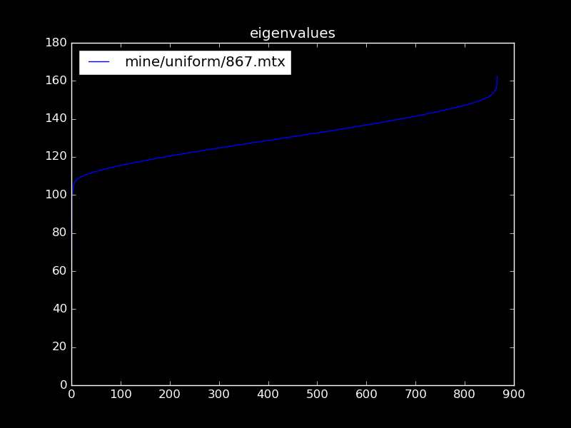
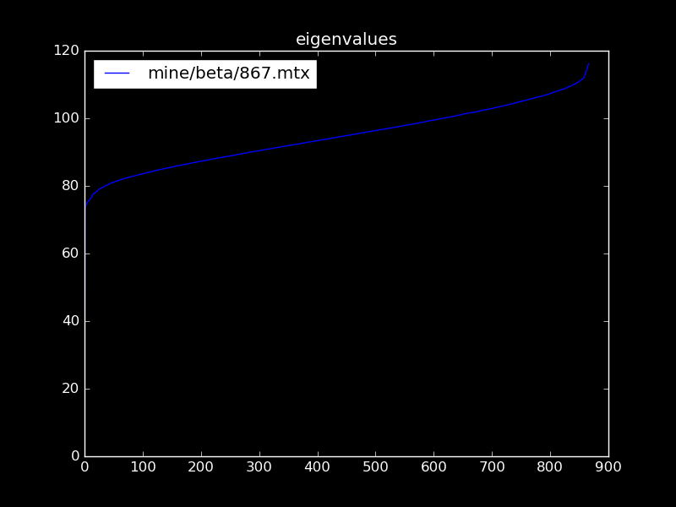
Idea2: eigenvalues function

Slide 14
Idea2: what if ...
We can see that eigenvalues function has a quite different shape in domain matrix.
Despite distribution, our random matrices have quite similar eigenvalues function (just differ in how far is starting point; but both are distant from zero).
What if we generate random symmetric matrices with same first eigenvalue (zero), and same second smallest eigenvalue as domain matrix?

Slide 15
Idea2: is it possible?
Symmetric matrices have only real eigenvalues.
Every real symmetric matrix is diagonalizable (Spectral Theorem).
D = Q^{T}AQ => A = QDQ^{T}
The diagonal matrix D can be set at will, while the orthonormal matrix Q can be randomly generated (random matrices are non-singular with probability 1, hence can orthogonalize).

Slide 16
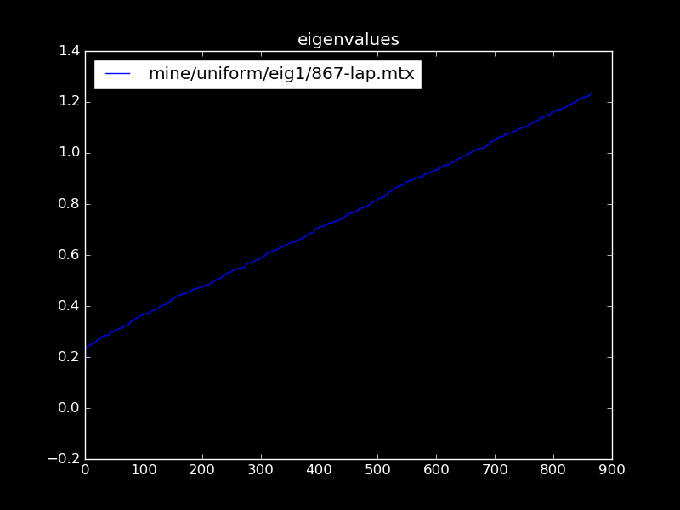
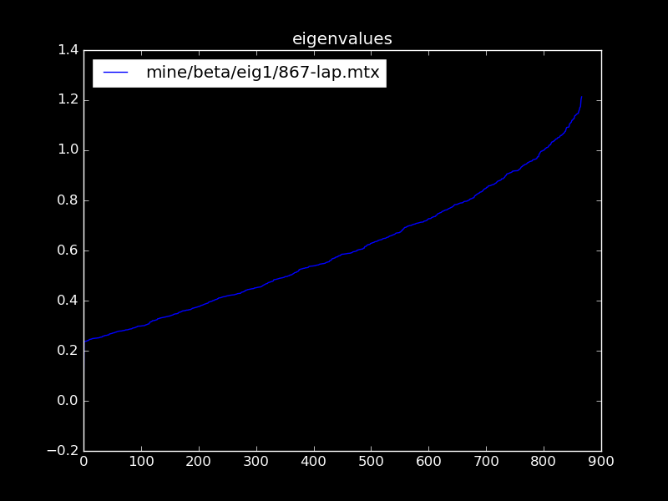
Idea2: same snd eigenvalue

Slide 17
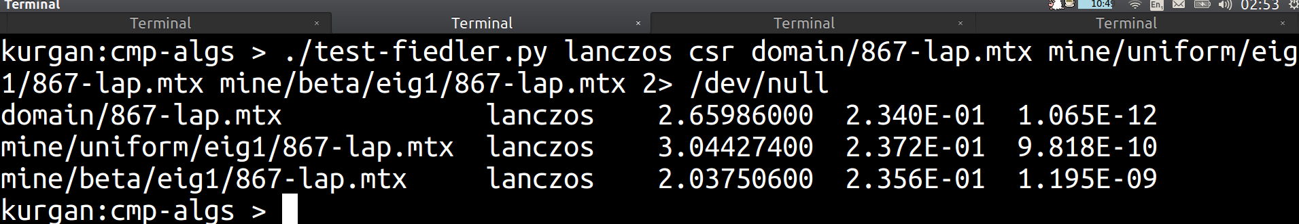
Idea2: #SUCCESS
Can we reproduce slowness of domain matrix with random matrices built to have same 1-2 eigenvalues? Yes
Watch out error (for spectral decomposition "looks" good).

Slide 18
Idea3: what if ...
We just saw that the important piece to reproduce slow convergence for Lanzos, are the eigenvalues (at least the smallest and second smallest, which are the ones we request to ARPACK).
What if we generate the random matrices to have not only same 1st/2nd eigenvalues, but all same eigenvalues as domain matrix?

Slide 19
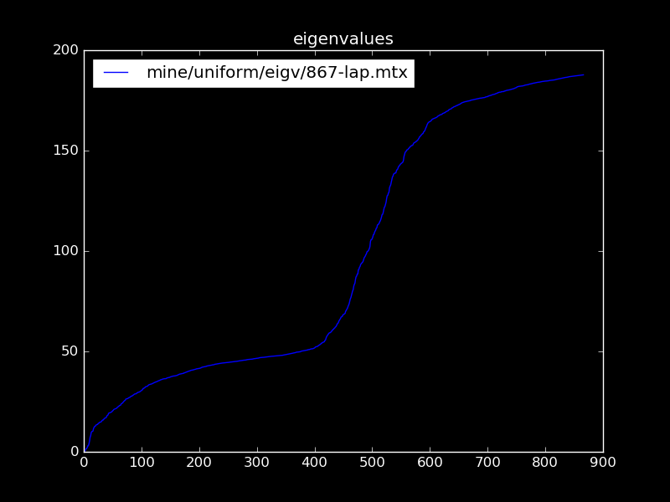
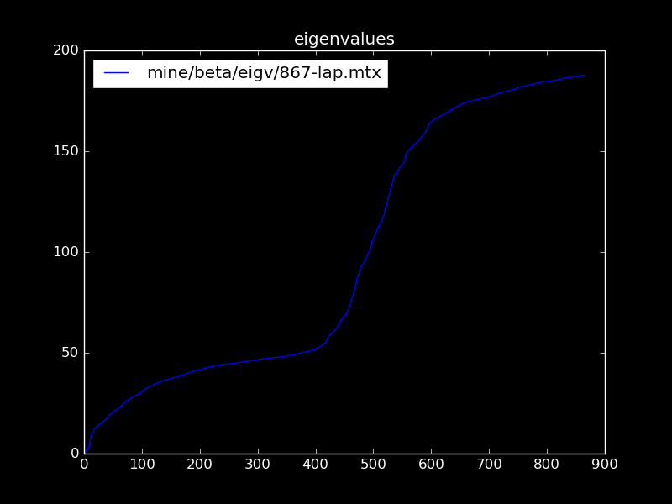
Idea3: eigenvalues function

Slide 20
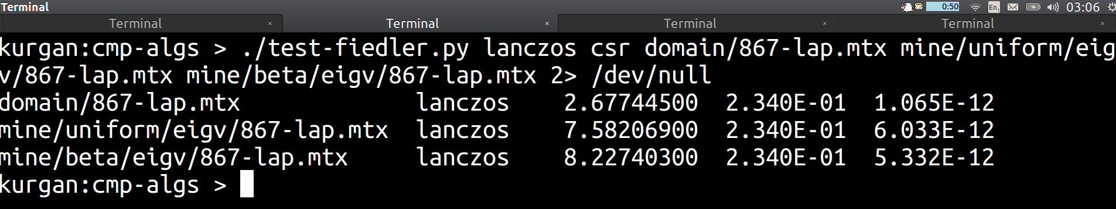
Idea3: #SURPRISE
Can we reproduce slowness of domain matrix with random matrices built to have same eigenvalues?
The slowness is actually worse! This came as surprise and requires further analysis.

Slide 21
Idea4: How to fix it?
Reproducing same or worse slowness, by forcing same eigenvalues, is good but … how to avoid the slowness?
Underlying routine is Python NetworkX, which uses Python Scipy's eigsh, which in turn uses Fortran77 ARPACK's dsaupd/dseupd routines.
ARPACK routines support "which" parameter, to indicate if we want smallest (SM) or largest (LM) eigenvalues (+)
NetworkX computation of 2nd eigenvalue uses SM, aha!

Slide 22
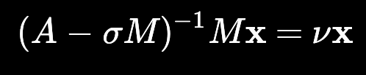
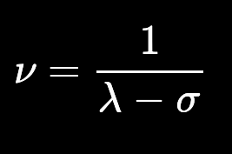
Idea4: Read the manual
NetworkX usage of which=SM, while calculating 2nd eigenvalue, is most likely an unintended mistake.
ARPACK and Scipy manuals clearly indicate that the algorithm works better with which=LM (seek largest).
Suggestion is to use the so called Shift-Inverted mode:

Slide 23
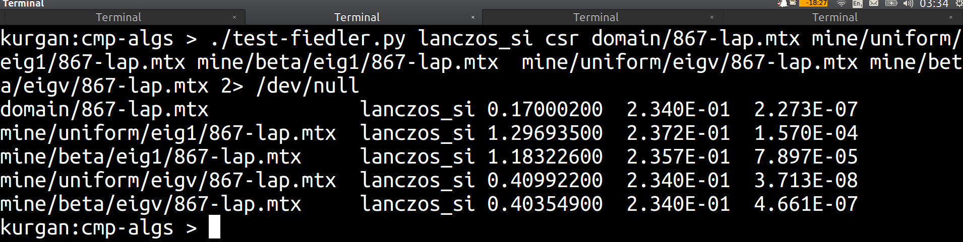
Idea4: does it work? partially
Can we avoid slow convergence on random matrices, by using Shift-Invert mode of IRLM?
For the domain matrix, and those with same eigenvalues, it works! Need to check the case of fixed 2nd eigenvalue.

Slide 24
Idea5: exploit the Laplacian
In certain phorum someone suggested to exploit the fact that we know fst eigenpair for Laplacian matrices (zero/1).
Use (spectral) transformation L - svv^{T}
Above "moves" the eigenvalues such that snd becomes first one (so we do not waste time calculating zero).
If combined with Shift-Invert mode could lead better convergence … shall we?

Slide 25
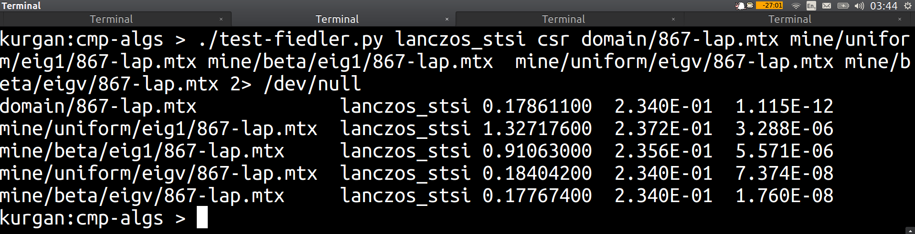
Idea5: does it work? yes
Can we avoid improve convergence on random matrices, by using not only Shift-Invert mode but spectral trans?
Not much difference for domain matrix, but random ones get better convergence. Further analysis worth it? ...

Slide 26
Idea5: loss of sparsity
While using the spectral transformation, in addition to Shift-Invert mode, can lead to faster convergence there is an issue … books say we shall not change sparsity!
The rank-1 matrix svv^{T} is dense, hence by subtracting it from the Laplacian we will make it lose its sparsity!
Being sparse was the main reason for using Lanczos's based algorithm; so this "optimization" is not worth it (specially for bigger dimensions).

Slide 27
Application context
Pending questions left as homework
Is it possible to use native libraries? In principle yes, but custom process is required (may difficult approval) => Java version is needed for sure.
How much RAM available? Not sure yet, but got access to Repository where I can build at will more domain generated matrices. Range of 1000-5000 seems suitable for available data (and fits well in commodity hardware).

Slide 28
Scope: focus on Lancos-IRLM
Original estimation of 254 hrs seems short, have consumed already 164!
Digging further implies going beyond the "black box", and actually understand full details of algorithm (Math!).
Definitely need to pick one algorithm among Lanczos (IRLM), TraceMIN-Fiedler and LOBPCG (disclaimer).
Lanzos (IRLM) has the more mature implementation (ARPACK), as well as extensive literature. Pick this one!

Slide 29
Scope: port ARPACK to Java!
One common complaint is that there is no official ARPACK repository (eg like open-source repo).
Given the above, Scipy bundles arpack-ng, an opensource collaboration to have a maintained version of ARPACK.
Fortran77 code is … hard to grasp. In addition, our application needs a Java solver (regardless of native libs).
Opportunity: port to Java the minimum needed to calculate the second eigenpair!

Slide 30
Scope: modern OO ARPACK !
ARPACK solves the generalized eigenvalue problem, has several features beyond Shift-Invert mode, and its routines come in several flavours (single/double/complex).
Can focus on porting to Java only the pieces needed for Spectral Decomposition: standard eigenvalue problem, double precision, with Shift-Invert mode.
Idea is not only offer Java port, but actually a modern, understandable Object-Oriented version! (bigQ: how much performance can you sacrifice for readability?)

Slide 31
Scope: port ARPACK to Java!
Doing a modern backport of ARPACK to Java, even if restricted to our needs, sounds like a good contribution to community (assuming we can open-source it .. ask for it!).
It goes hand by hand with desire to go beyond black-box approach: what better excuse to grasp the theory behind the algorithm, than to actually re-implement it?
Mastering an implementation can help in understanding the convergence speed and errors (which so far have been covered almost empirically).

Slide 32
Incremental approach ...
The Lanczos variant to backport to Java, IRLM, can be seen as a series of algorithm refinements that begin with the Power Method.
Each refinement has theory behind, and brings a concrete numerical benefit to the implementation.
Try to mirror such incremental approach in the thesis: let the chapters represent the refinements, each containing the theory and associated code/design (relevant pieces).
Existing first chapter can stay (problem motivation).

Slide 33
Summary
Focus on Lanczos algorithm (IRLM variant in ARPACK).
Need deep understanding of algorithm, in order to explain properly convergence and errors observed with data.
Include OO port of ARPACK to Java (just enough).
Plan rest of chapters as progression of theory/code, that evolve Power Method into IRLM (self-contained).
Each chapter (refinement) shall explain theory (main theorems), map that into modern OO code, and show how it improves results with test-bed (5+5).

